Slide 1
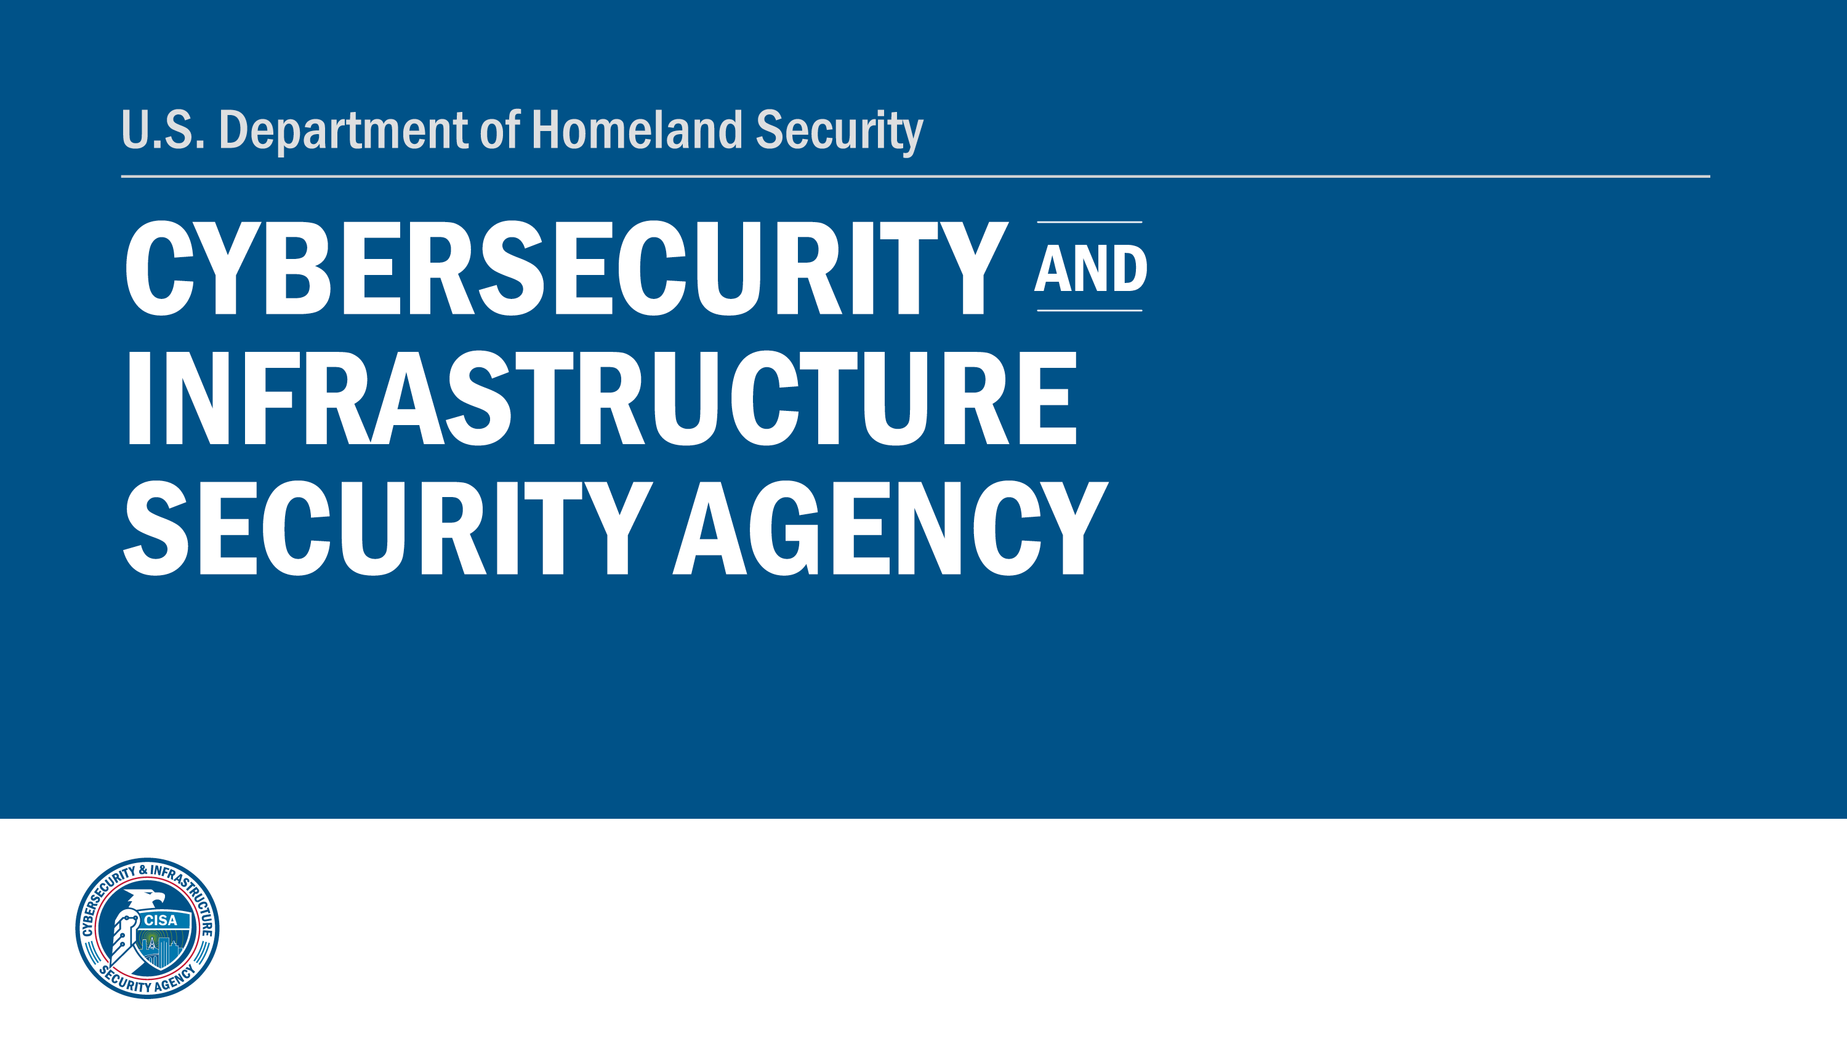

Slide 2
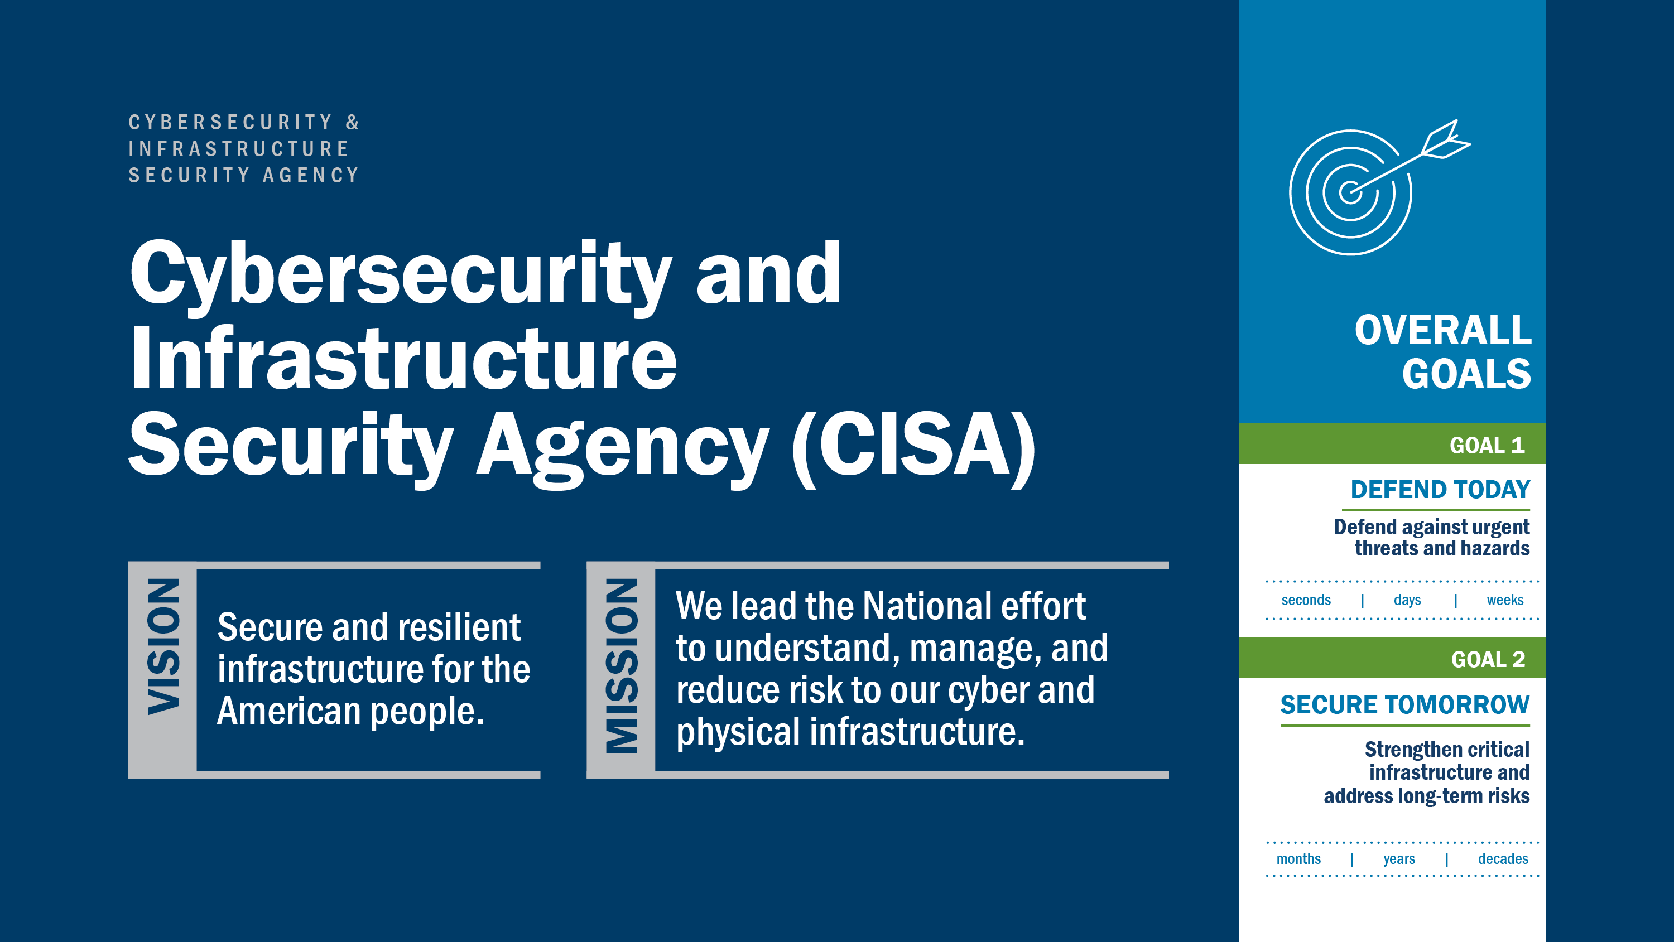

Slide 3
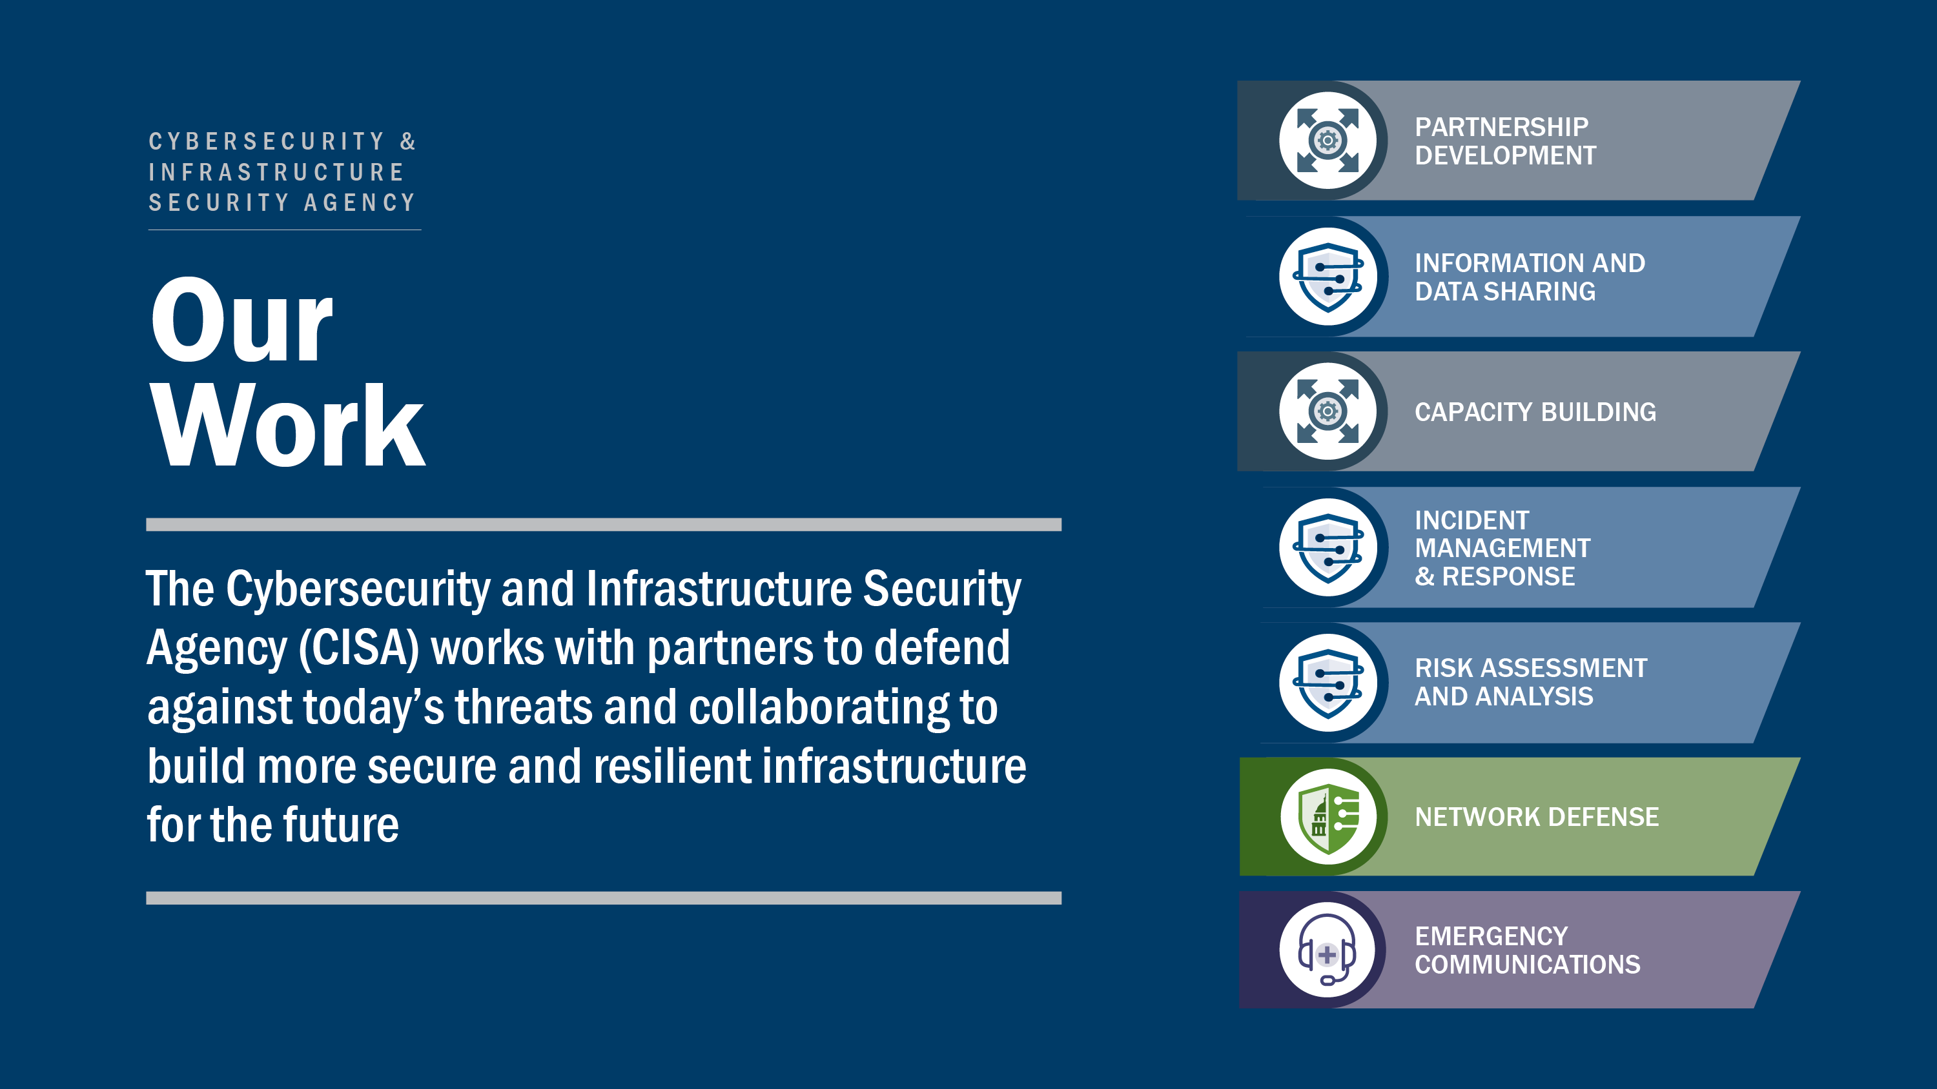

Slide 4
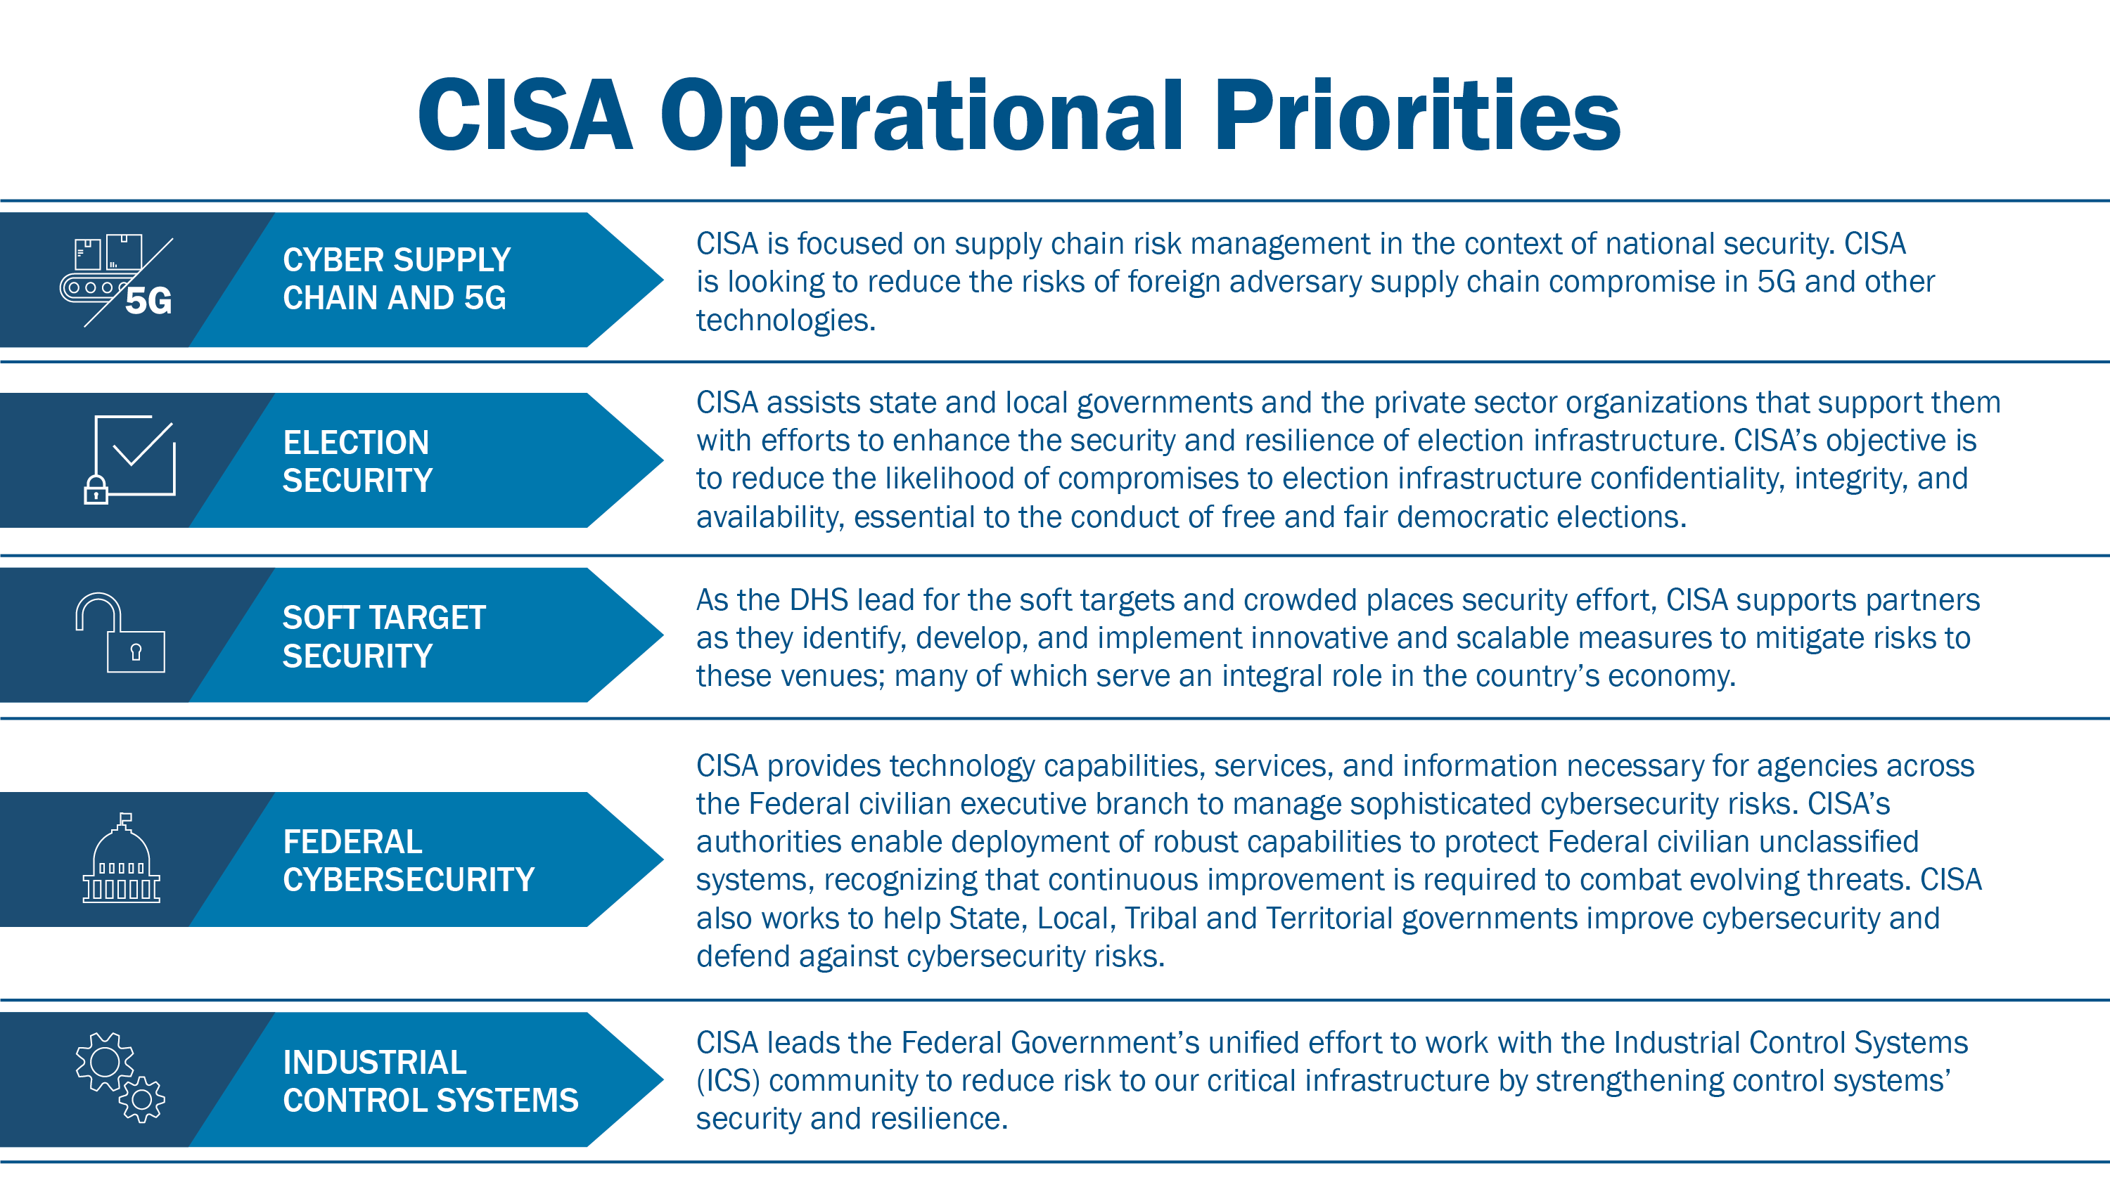

Slide 5
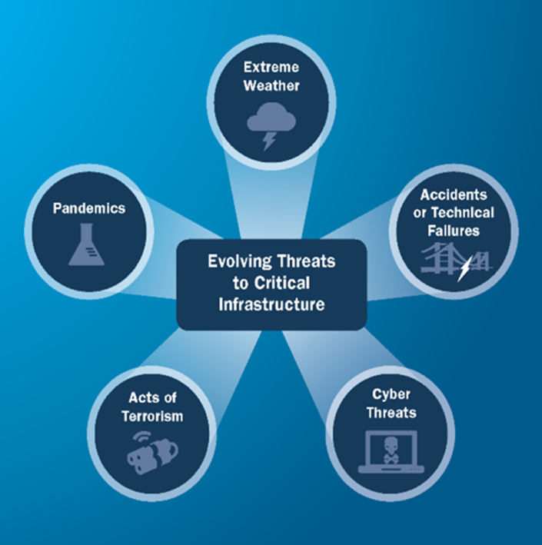
Critical Infrastructure Resilience
Resilience:
The ability to prepare for and adapt to changing conditions and withstand and recover rapidly from disruptions, including deliberate attacks, accidents, or naturally occurring hazards. Source: PPD-21
Critical Infrastructure:
Systems and assets, whether physical or virtual, so vital that its incapacity or destruction may have a debilitating impact on the security, economy, public health or safety, environment, or any combination of these matters, across any Federal, State, regional, territorial, or local jurisdiction. Source: NIPP 2013

Slide 6
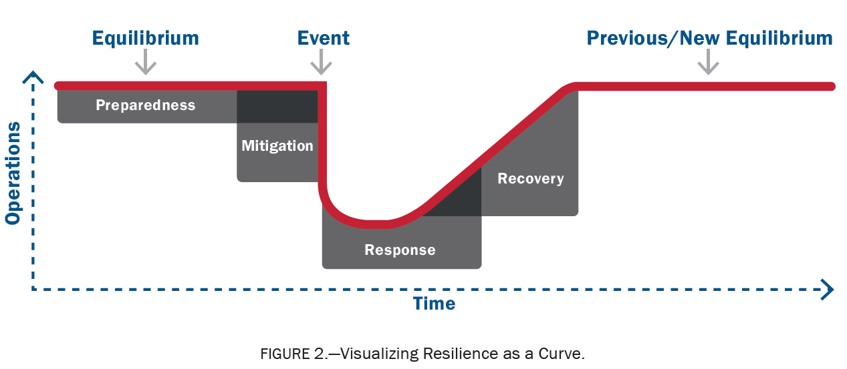
Critical Infrastructure Resilience
Continued
Core building blocks of Resilience
Preparedness | Mitigation | Response | Recovery

Slide 7
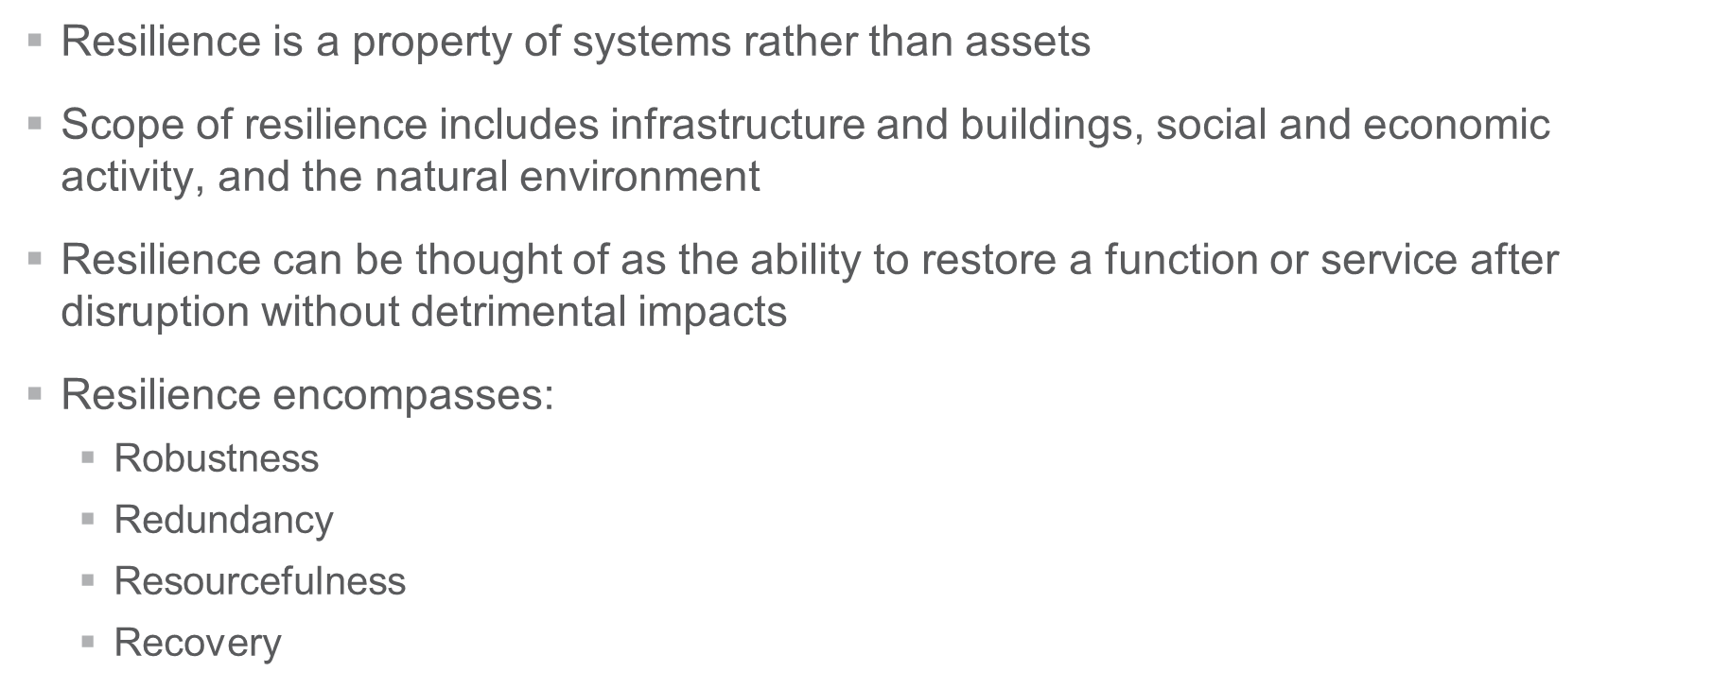
Critical Infrastructure Resilience
Continued
Resilience Principles

Slide 8
Critical Infrastructure Resilience
Continued
Context is Important
What functions are important to the local community, the region, the nation?
How are they delivered (e.g., buildings, infrastructure systems)?
What are the services dependent on?
For example, water treatment requires electric power, communications, access via transportation networks for chemicals, source water, pipes, and equipment to distribute treated water.
How long can the service be interrupted? Are there temporary means to deliver the service until the permanent system is restored?

Slide 9
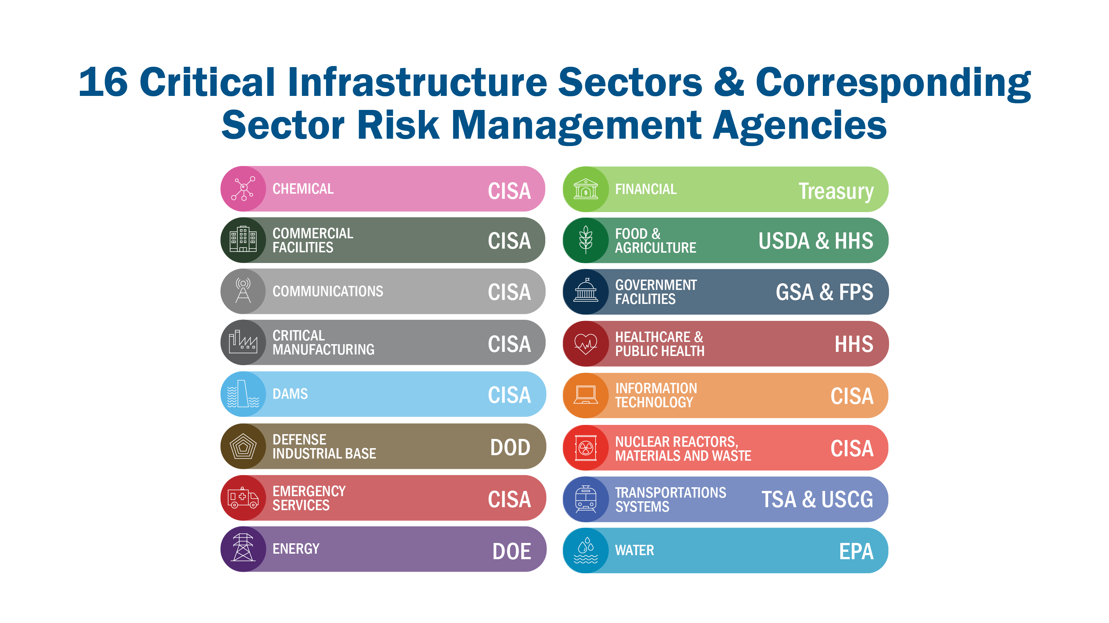

Slide 10
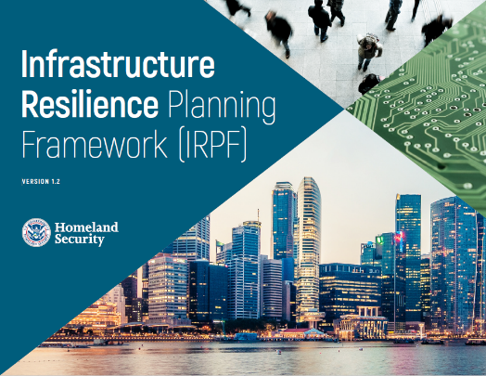
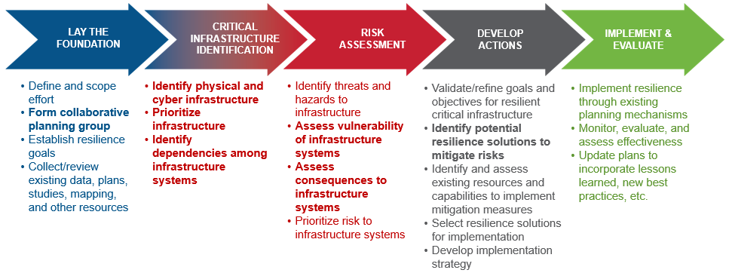
Critical Infrastructure Resilience
Infrastructure Resilience Planning Framework (IRPF)
  Includes step-by-step planning guidance, templates, and other resources to inform long-term planning and investment decisions
  Five steps from stakeholder engagement to risk assessment and implementation

Slide 11
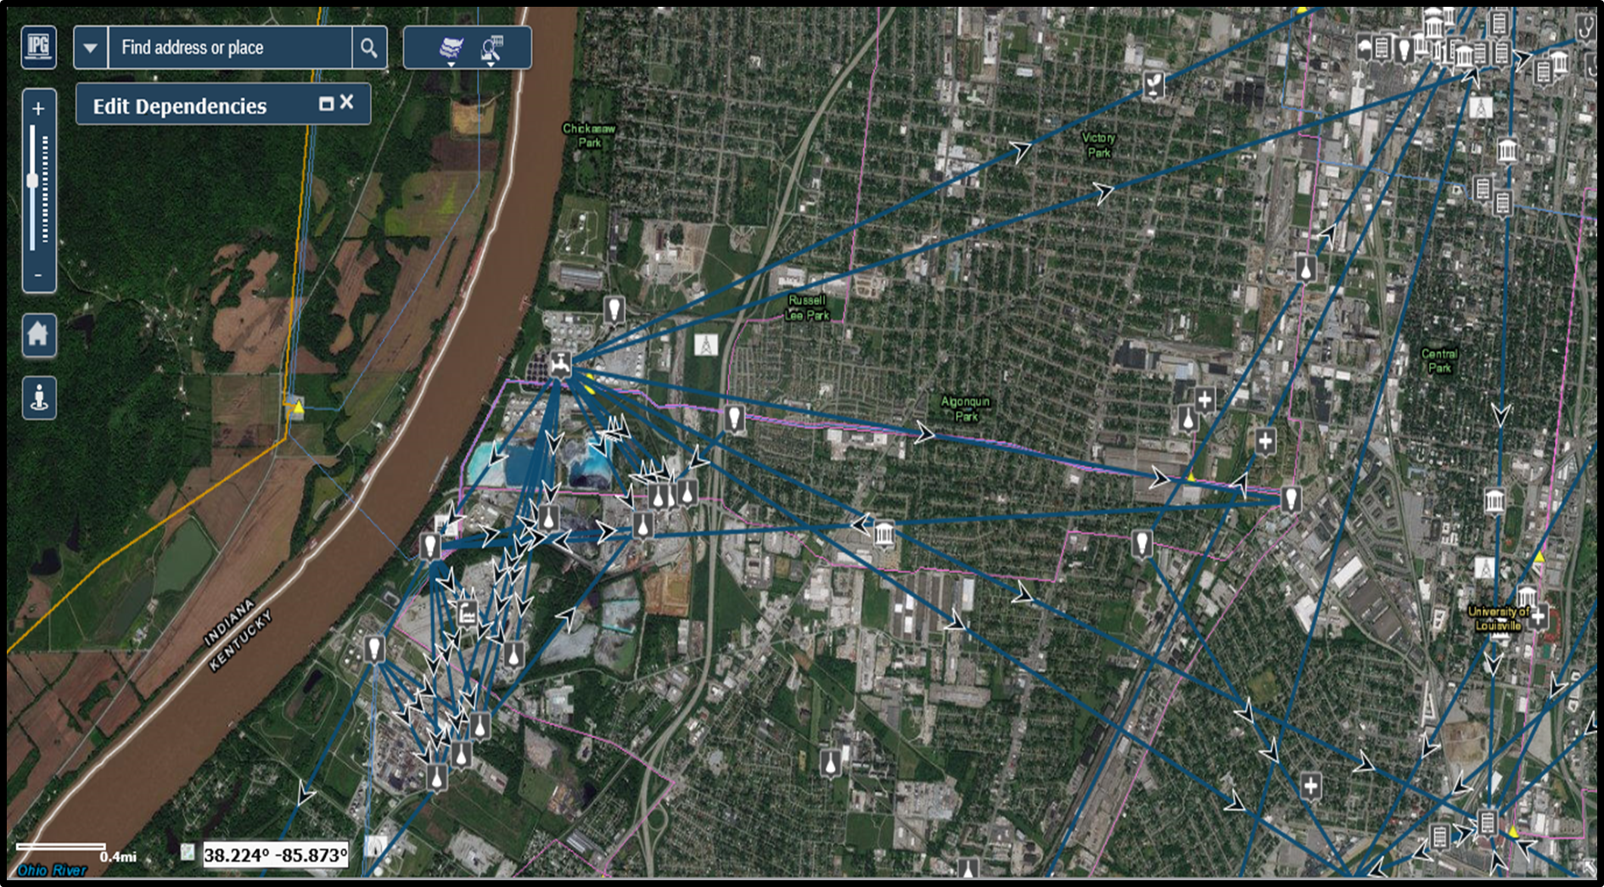
Critical Infrastructure Resilience
Regional Applications
Critical systems transcend local boundaries
Characterized by shared infrastructure dependencies/interdependencies
Can consider single infrastructure systems/
sectors at regional scale
Examples of regional infrastructure include:
  Ports/multimodal transportation systems
  Electrical grid
  Regional water/wastewater systems
  Natural gas network

Slide 12
RRAP Focus and Objectives
Regional Resiliency Assessment Program (RRAP): Region 1 Information and Communications Technology Project
  Identify the location and description of critical assets whose disruption could result in major impact to the lifeline critical infrastructure
  Analyze why these critical assets (data center/internet exchange points etc.) are important to the overall function of New England, lifeline infrastructure operations and their associated dependencies
  Assess the downstream effects to lifeline sectors as a result of short or long-term loss or degraded capabilities of the assets
  Assess the collective preparedness and protection capabilities of the sectors from both a physical and cyber standpoint
  Provide a guidepost to inform state and local prioritization plans

Slide 13

Multi-Asset and System Assessment (MASA)
The MASA process allows the enterprise to compare assets based on criticality, attack type susceptibility, and vulnerability. The process includes one or more facilitated discussion and data collection sessions. Deliverable products are a navigable report and dashboards. Overall timeframe is 2-6 months, based on stakeholder availability.
Current Region 1 MASA of Massachusetts Port Authority
Aviation:
  Logan (international), Worcester (regional), and Hanscom (regional) Airports
Port:
  Connelly Terminal (containers), Black Falcon Piers (passenger), and Fish Piers (seafood)

Slide 14
National Critical Functions | Framework Overview
Agenda Item 1 | NRMC Overview | Agenda Item 3 | Agenda Item 4
The National Critical Functions Framework reaches across sectors and industries to focus on a holistic, outcomes-based approach to managing risk.
What are National Critical Functions (NCFs)?
NCFs are functions of government and the private sector so vital to the United States that their disruption, corruption, or dysfunction would have a debilitating effect on security, national economic security, national public health or safety
  Cross-Cutting View
  Risk Through a Functional Lens
NCFs provide a cross-cutting, multidimensional view of risk to critical processes, infrastructure, and assets
By viewing risk through a functional lens, NRMC can better understand national-level and systemic risk that could cause broad, cascading impacts across sectors
The NCF Framework provides a multidimensional, dynamic view of risk, capturing previously unseen relationships and dependencies from critical technologies and supply chains that support NCF operations

Slide 15
55 National Critical Functions | NCF Set
CONNECT
DISTRIBUTE
MANAGE
SUPPLY
SUPPLY
Operate Core Network
Provide Cable Access Network Services
Provide Internet Based Content, Information, and Communication Services
Provide Internet Routing, Access and Connection Services
Provide Positioning, Navigation, and Timing Services
Provide Radio Broadcast Access Network Services
Provide Satellite Access Network Services
Provide Wireless Access Network Services
Provide Wireline Access Network Services
Distribute Electricity
Maintain Supply Chains
Transmit Electricity
Transport Cargo and Passengers by Air
Transport Cargo and Passengers by Rail
Transport Cargo and Passengers by Road
Transport Cargo and Passengers by Vessel
Transport Materials by Pipeline
Transport Passengers by Mass Transit
Conduct Elections
Develop and Maintain Public Works and Services
Educate and Train
Enforce Law
Maintain Access to Medical Records
Manage Hazardous Materials
Manage Wastewater
Operate Government
Perform Cyber Incident
Management Capabilities
Prepare For and Manage Emergencies
Preserve Constitutional Rights
Protect Sensitive Information
Provide and Maintain Infrastructure
Provide Capital Markets and Investment Activities
Provide Consumer and Commercial Banking Services
Provide Funding and Liquidity Services
Provide Identity Management and Associated Trust Support Services
Provide Insurance Services
Provide Medical Care
Provide Payment, Clearing, and Settlement Services
Provide Public Safety
Provide Wholesale Funding
Store Fuel and Maintain Reserves
Support Community Health
Exploration and Extraction Of Fuels
Fuel Refining and Processing Fuels
Generate Electricity
Manufacture Equipment
Produce and Provide Agricultural Products and Services
Produce and Provide Human and Animal Food Products and Services
Produce Chemicals
Provide Metals and Materials
Provide Housing
Provide Information Technology Products and Services
Provide Materiel and Operational Support to Defense
Research and Development
Supply Water

Slide 16
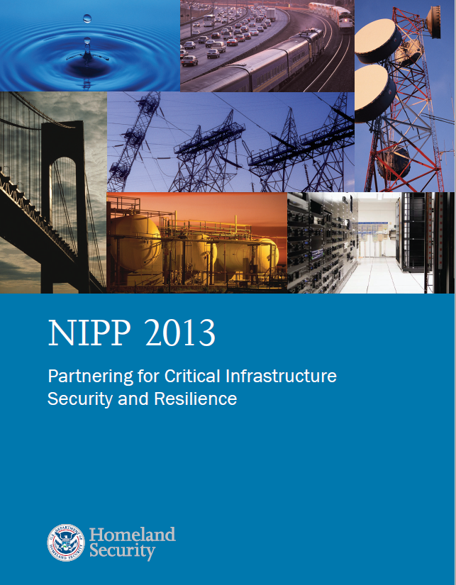
National Plan Update
Formerly known as “National Infrastructure Protection Plan” or NIPP
Last published in 2013
CISA is leading the U.S. Government
effort to update the National Plan

Slide 17
National Plan Update
Continued
  2021 NDAA Codified Sector Risk Management Agencies (formerly Sector-Specific Agencies)
  It requires CISA to:
    Coordinate with the heads of SRMAs to review the existing framework for national coordination described in the 2013 National Plan, and
    Make recommendations for revising and updating that framework, including modifying the sector structure and alignment of sectors to SRMAs.
    To support the release of the 2022 National Plan, CISA is leveraging previous National Plan efforts, seeking stakeholder feedback, and addressing all statutory requirements.
    Anticipated release of 2022 National Plan to partners in the coming months
    Final plan released in Fall 2022.

Slide 18

Questions

