Slide 1

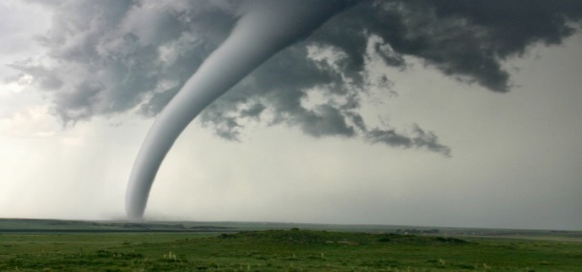

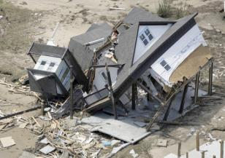
June 2022
https://www.emacweb.org/

Slide 2

EMAC Overview
The Emergency Management Assistance Compact (EMAC), is a State-to-State mutual aid compact that facilitates the sharing of services, personnel and equipment across state lines during times of disaster and emergency.
Under EMAC, a state can share any resource with another member state so long as the Governor of the impacted state has declared a state of emergency.
EMAC enacted into Federal Law in October 1996.
https://www.emacweb.org/index.php/learn-about-emac/emac-legislation
https://youtu.be/Gc8oHnu0PxE

Slide 3





EMAC Overview – Member States
Puerto Rico
Guam
Puerto Rico
Guam
All 50 United States
All 50 United States
U.S. Virgin Islands
District of Columbia
U.S. Virgin Islands
District of Columbia

Slide 4
EMAC Overview – What EMAC Does
Provides a responsive and straightforward mutual aid system for sharing resources
Maximizes the use of available member state resources
Establishes a firm legal foundation
  Provides immunity and tort protection
  Provides professional license reciprocity
Deploys resources as part of a coordinated response through the state EMAs (resources do not self-deploy)
Is the primary mutual aid resource provider when federal support is not warranted
Supports state response and recovery operations while respecting state sovereignty
Authorizes use of the National Guard in State Active Duty or Title 32 status.

Slide 5
EMAC Overview – What EMAC Does NOT do
Endorse self-deployment
Replace the need for Federal support
Replace existing mutual aid agreements
Hoard / stockpile / prioritize / allocate resources
Permit the use of the National Guard resources for military purposes
Move resources directly from county-to-county or city-to-city level.
(EMAC is state-to-state only)

Slide 6
EMAC Overview
State / County / Local EOC support Hazard mitigation
Damage assessment Community outreach
Disaster recovery services Search and Rescue
Logistics support Debris clearance services
Donations management Public Health services
Law Enforcement services Environmental Health services
Communications HazMat response teams
Firefighting Human services / Mass Care
Aviation support Animal control services
Biological/chemical response teams Incident Management Teams
Medical support services National Guard support
Any capability from Member States can be shared
* Deployment under EMAC follows the incident command system – keeping the mission under the control of the state.

Slide 7




EMAC Overview – EMAC Process
PRE-EVENT PREPARATION
The EMAC Process:
comprises five distinctive phases
involves states affected by an emergency as well as states assisting them
begins before emergency occurs
ends when Requesting State reimburses Assisting State
ACTIVATION
REQUEST & OFFER
RESPONSE
REIMBURSEMENT

Slide 8
EMAC Overview – EMAC Process
Develop internal plans and procedures to implement the EMAC process.
Train local and state Resource Providers.
Establish Mission Ready Packages with estimated costs.
PRE-EVENT PREPARATION
Local resources exhausted or anticipated to be exhausted
Governor declares a State of Emergency
Affected state opens an event in the EMAC Operating System (EOS)
ACTIVATION

Slide 9
EMAC Overview – EMAC Process
A-Team inputs resource requests into the EMAC EOS and broadcasts requests to designates states.
Assisting states work on offers of assistance. All costs included.
Resource Support Agreements (RSAs) finalized.
REQUEST & OFFER
Resources prepare to deploy.
Deploying personnel receive a pre-deployment briefing.
Keep track of all costs, damages, issues, etc.
  Dedicated finance/logistics member recommended for larger teams.
Keep contact with home state representatives.
Demobilize and return to home state.
RESPONSE

Slide 10
EMAC Overview – EMAC Process
REIMBURSEMENT
Resource Provider submit reimbursement package to the Assisting State
  This should be completed once payroll records can be provided
  (~2 weeks after mission ends, NLT 45 days after mission ends)
Assisting State audits package and sends to Requesting State
  This should be completed NLT 45 days after receiving package from the Resource Provider.
Requesting State audits package and issues payment to Assisting State
  This should be completed NLT 45 days after receiving package from the Assisting State.
Assisting State reimburses Resource Providers
  This should be completed NLT 45 days after receiving funds from the Requesting State.

Slide 11
EMAC Overview – EMAC Process Summary
Governor declares a state of emergency due to a natural or man-made disaster.
State requests resources from EMAC member states through the EMAC EOS.
State emergency management personnel and local resource providers work together to identify available resources and estimated mission costs.
The Requesting and Assisting States execute the EMAC Resource Support Agreement (RSA).
Personnel deploying are given a Mission Order Authorization Form which outlines the mission, helpful information, and guidance.
At the completion of the mission, resources demobilize and return to the home state.
Deployed personnel provide required documentation to assemble reimbursement packages.
Reimbursement package is sent to the Requesting State.
Requesting State reimburses the Assisting State.

Slide 12
EMAC Operations Manual
New Resource Support Agreement (RSA)
    3-part REQ-A has been replaced by 2-part RSA.
    The EOS facilitates the completion of the RSA after an offer of assistance is accepted. RSAs are generated through the EOS and printed, signed, scanned, and uploaded into the EOS.
    The RSA Form has two sections:
      Section I contains the Request and Offer, and is completed by the Assisting State
      Section 2 is the Acceptance of the Offer, and is completed by the Requesting State
    EMAC allows for Members to request and provide assistance verbally and in writing. Verbal agreements made between EMAC Authorized Representatives must be confirmed by completing the RSA within 30-days of the verbal request.
    Caution should be used for verbal agreements as they are legally binding.

Slide 13
EMAC Operations Manual
Reimbursement Information
  A clear understanding of reimbursement requirements above and beyond what is required by EMAC reimbursement guidelines as identified in the RSA to include cost tracking procedure requirements (e.g., timesheets, mileage logs, etc.) and purchasing procedures.
  New R-2: Intrastate Reimbursement Form
  New Reimbursement Package Job Aid / Fringe Benefit Job Aid

Slide 14
EMAC Operations Manual
Reimbursement Information
  States will not deny the reimbursement of a cost because of differences in “documentation appearance”. Each reimbursement package requires certification by both the Resource Provider and Assisting State for the completeness and accuracy of costs. However, all documents should meet the definition of a Source Document.
    A source document is an original record which contains the detail that supports or substantiates a transaction that will be (or has been) entered in an accounting system.
  Claims for reimbursement may only be for costs that occur during the EMAC mission period. Pre- and post-deployment costs are not eligible for reimbursement unless agreed to on the RSA.

Slide 15
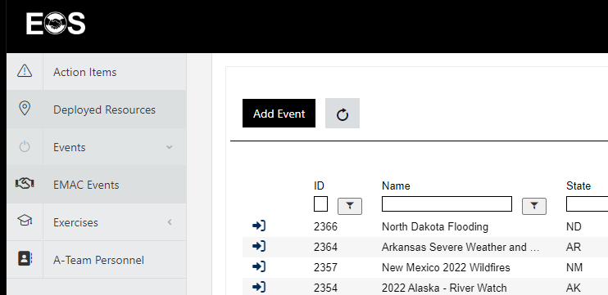
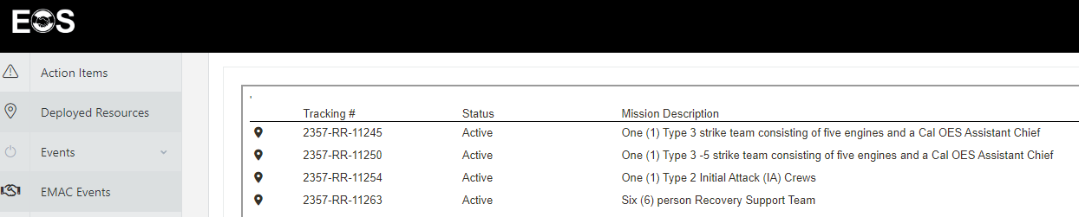
EMAC Operations Manual
Updated EMAC Operating System (EOS)
Notes:
The offer NEMA made to open the EMAC Operations System up to IEMG (and the other international compacts) is still open but to do that IEMG would have to adopt the 2 part RSA.

Slide 16
EMAC A-Team Training
Online Training – must be nominated by state to enroll.
Familiarize students with the EMAC A-Team's structure, functions, roles, responsibilities, and provide experience in the EMAC Operations System.
Students are nominated by state EMA representatives.
  These individuals must have strong leadership skills and substantial knowledge about mutual aid and EMAC.
  Audience should be experienced, all-hazards personnel
https://www.emacweb.org/index.php/a-team-training-course-summary

Slide 17
EMAC A-Team Training
Course Pre-requisites:
  The Practice and Implementation of EMAC
  EMAC: Pre-Event Preparation for Resource Providers
  EMAC: Just in Time Training for Deploying Personnel
  EMAC: Bootcamp for Authorized Representatives Course
  The National Guard and EMAC
  EMAC: Reimbursement for State Emergency Management
https://www.emacweb.org/moodle/

Slide 18
EMAC A-Team Training
Course:
  Complete 8 training modules in eLearning Center
  Complete Assessment (passing grade 80%)
  Complete Navigation Exercise
  Complete EOS Sandbox Exercise
  Complete Course Evaluation
Course Completion Time: on average 12-16 hours to complete
183 students have graduated from the A-Team online course since September 2020.

Slide 19
Questions?
Jaci Hamel
Operations Unit Supervisor
MA Emergency Management Agency
EMAC Lead State Representative – FEMA Region 1
Jaclyn.Hamel@mass.gov
“NOT IF, BUT WHEN”

